Slide 1

NetDIMM: Low-Latency, Near-Memory Network Interface Architecture
Mohammad Alian, and Nam Sung Kim
Electrical and Computer Engineering
University of Illinois Urbana-Champaign

Slide 2
Current Network Performance Trend in Datacenters
*based on Infoneticsc forcasts
Higher and higher bandwidth
100GE
40GE
10GE
1GE

Slide 3
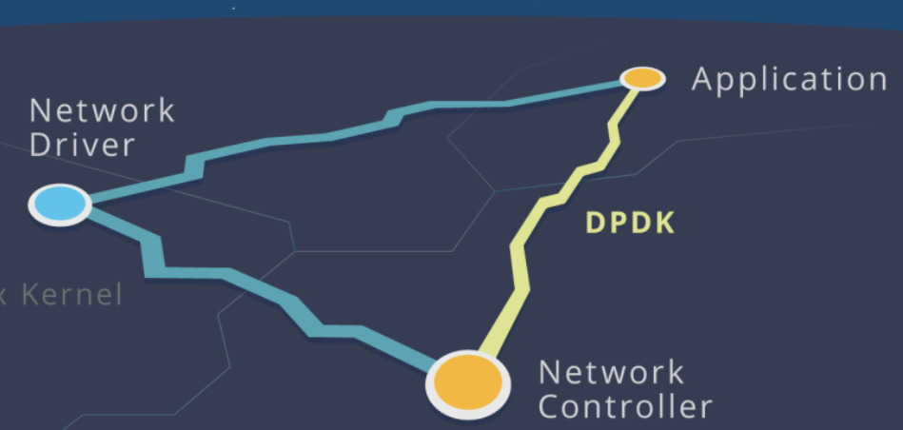
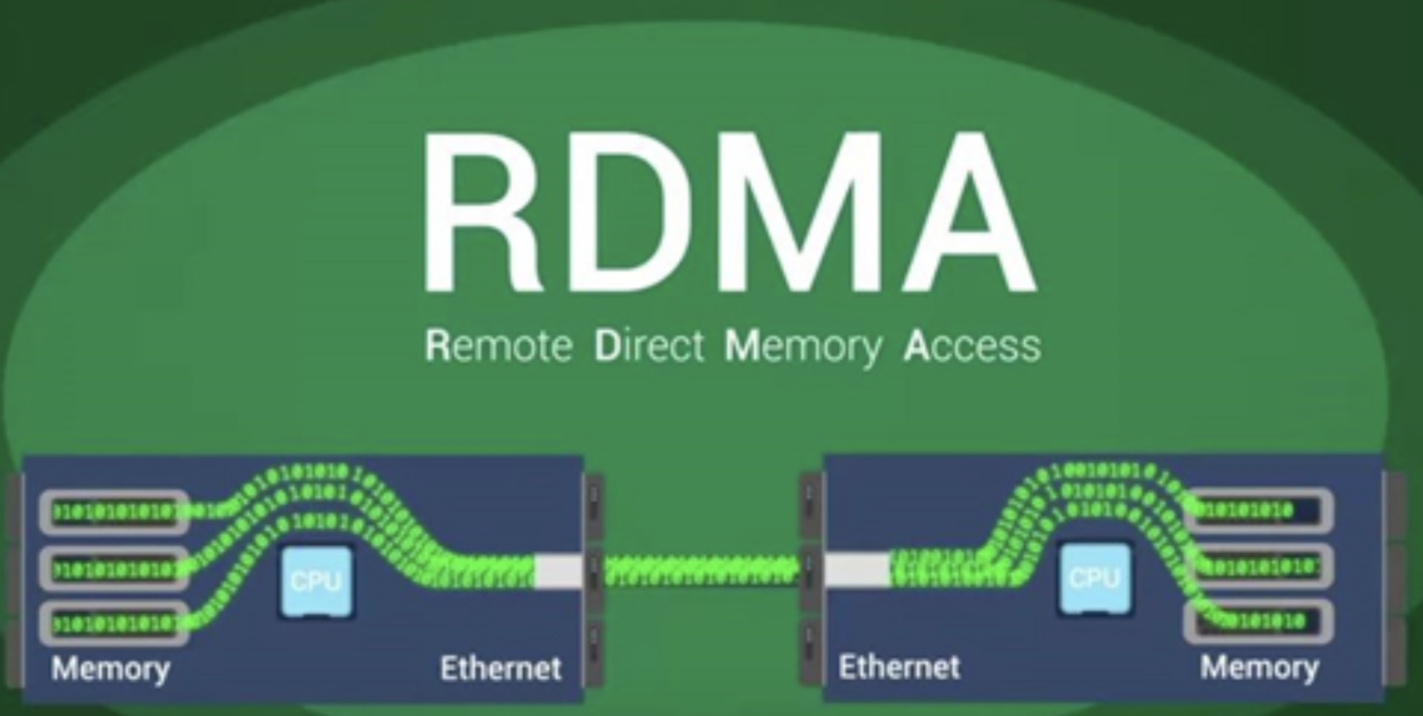
Current Network Performance Trend in Datacenters
*based on Infoneticsc forcasts
Higher and higher bandwidth
Innovations in network software stack to better utilize hardware
  Userspace networking (DPDK), software stack offloading (RDMA), etc.
Network latency approaches hardware limits
  ~2µ since the last decade!
100GE
40GE
10GE
1GE

Slide 4
Current Network Performance Trend in Datacenters
*based on Infoneticsc forcasts
Higher and higher bandwidth
Innovations in network software stack to better utilize hardware
  Userspace networking (DPDK), software stack offloading (RDMA), etc.
Network latency approaches hardware limits
  ~2µ since the last decade!
End to end hardware network latency?
  PCIe transactions contribute to up to 90% of
  network latency!
100GE
40GE
10GE
1GE
~77%
~90%
PCIe is the bottleneck in low-latency networking

Slide 5
Executive Summary
We need: ultra low-latency networking in datacenters
  Emerging scale-out applications: short/critical message latency & tail latency at scale!
  Software-defined datacenters, memory disaggregation

Slide 6
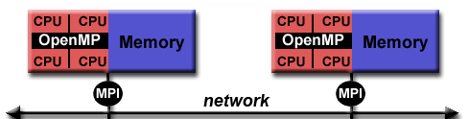
Executive Summary
We need: ultra low-latency networking in datacenters
  Emerging scale-out applications: short/critical message latency & tail latency at scale!
  Software-defined datacenters, memory disaggregation
💡Insight: What is the goal of networking?
  Inter-node memory copy
Picture taken from https://computing.llnl.gov/tutorials/parallel_comp/

Slide 7
Executive Summary
We need: ultra low-latency networking in datacenters
  Emerging scale-out applications: short/critical message latency & tail latency at scale!
  Software-defined datacenters, memory disaggregation
💡Insight: What is the goal of networking?
  Inter-node memory copy
Network-attached Dual-Inline Memory Module (NetDIMM)
  ✅ Remove transactions over PCIe for network TX/RX
  ✅ Higher aggregate system memory bandwidth
  ✅ In-memory buffer cloning support

Slide 8
Executive Summary
We need: ultra low-latency networking in datacenters
  Emerging scale-out applications: short/critical message latency & tail latency at scale!
  Software-defined datacenters, memory disaggregation
💡Insight: What is the goal of networking?
  Inter-node memory copy
Network-attached Dual-Inline Memory Module (NetDIMM)
  ✅ Remove transactions over PCIe for network TX/RX
  ✅ Higher aggregate system memory bandwidth
  ✅ In-memory buffer cloning support
Implementation & Performance: full-stack implementation on gem5
  50.7% & 30.9% lower netW latency & memory interference compared w/ PCIe NIC

Slide 9
Outline
Introduction
Background
  DDR5 asynchronous memory operations
Network-attached DIMM
  NetDIMM hardware architecture
  NetDIMM software architecture
Evaluation
Conclusion

Slide 10
Background: DDR5 Asynchronous Memory Access
Command bus
Row Acc
Col Acc
tRCD + tCAS (deterministic)
Data bus
data
DRAM Operation

Slide 11
Background: DDR5 Asynchronous Memory Access
Command bus
Row Acc
Col Acc
tRCD + tCAS (deterministic)
Data bus
data
DRAM Operation
⓵
⓷
Command bus
xRead
ADR
ID
Send
Nondeterministic
⓸
Data bus
ID
data
⓶
Resp bus
RDY
NVDIMM-P Operation

Slide 12
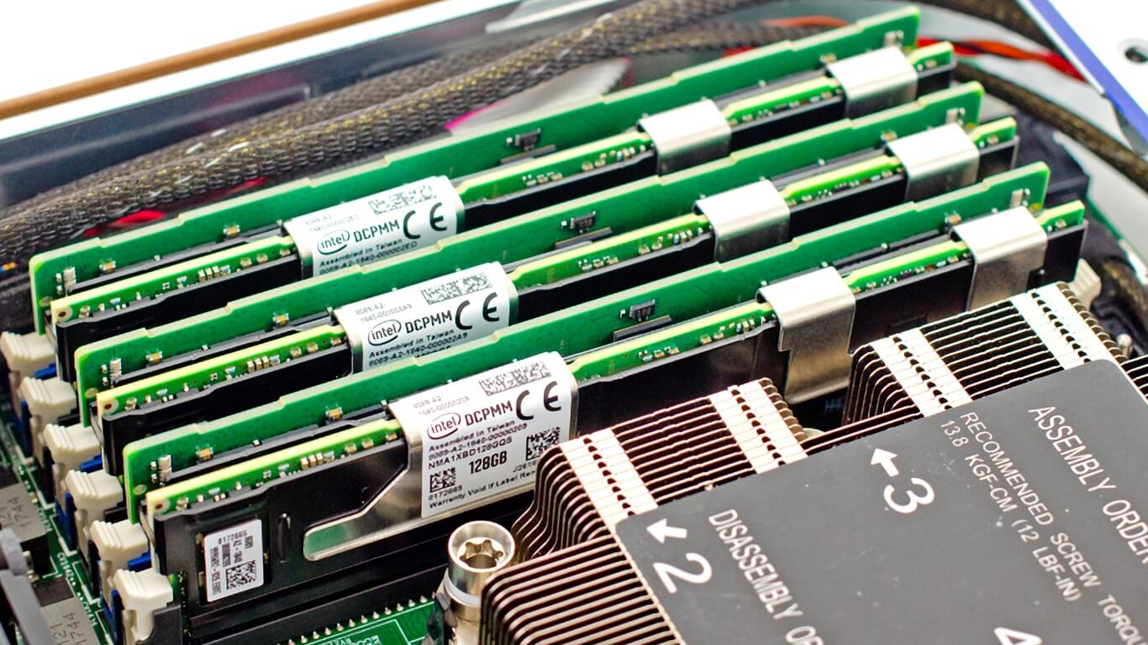
Background: DDR5 Asynchronous Memory Access
https://www.storagereview.com/node/7416
Command bus
Row Acc
Col Acc
tRCD + tCAS (deterministic)
Data bus
data
DRAM Operation
⓵
⓷
Mem Ctrl 0
NVDIMM-P
Send
DDR5 DIMM
Command bus
xRead
ADR
ID
Nondeterministic
⓸
Data bus
ID
data
⓶
Mem Ctrl 1
RDY
DDR5 DIMM
Resp bus
NVDIMM-P
NVDIMM-P Operation
Mix DIMMs with different access timing on one memory channel

Slide 13
Outline
Introduction
Background
  DDR5 asynchronous memory operations
Network-attached DIMM
  NetDIMM hardware architecture
  NetDIMM software architecture
Evaluation
Conclusion

Slide 14
NetDIMM Overall Architecture
Global/Shared Memory Channel
CPU
Mem Ctrl 0
NetDIMM
DDR5 DIMM
DDR5 DIMM
Mem Ctrl 1
DDR5 DIMM
NetDIMM
DDR5 DIMM

Slide 15
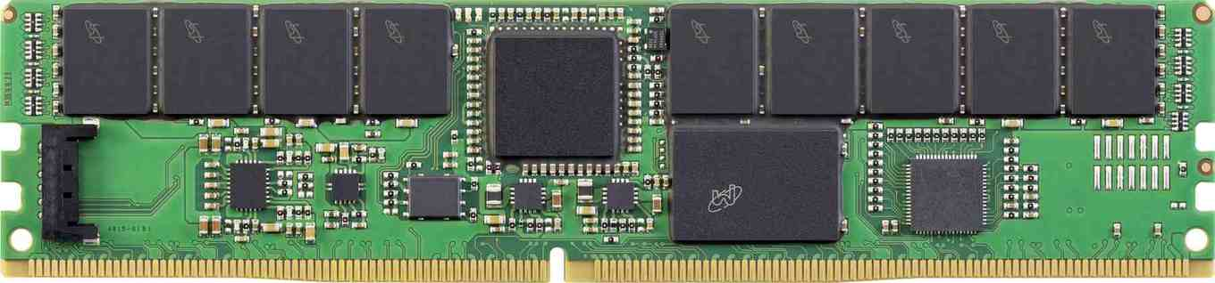
NetDIMM Overall Architecture
Local Memory Channel
Global/Shared Memory Channel
DRAM devices
CPU
Mem Ctrl 0
DRAM
DRAM
DRAM
DRAM
DRAM
DRAM
DRAM
DRAM
NetDIMM
DDR5 DIMM
DDR5 DIMM
NetDIMM Buffer Device
Eth
Buffer device + integrated NIC + other logic
Network
Connector
FPGA Controller
Mem Ctrl 1
DRAM Devices
DDR5 DIMM
NetDIMM
DDR5 DIMM
Power
connector
Micron’s NVDIMM
Buffered DIMM with an integrated NIC in a buffer device

Slide 16
NetDIMM Overall Architecture
Local Memory Channel
Global/Shared Memory Channel
CPU
Mem Ctrl 0
DDR Memory
DRAM
DRAM
DRAM
DRAM
DRAM
DRAM
DRAM
DRAM
NetDIMM
DDR Memory
DDR5 DIMM
DDR5 DIMM
DDR Memory
CPU
NetDIMM Buffer Device
Eth
DDR Memory
CPU
DDR Memory
CPU
CPU
Mem Ctrl 1
CPU
DDR5 DIMM
NetDIMM
DDR5 DIMM
Micron’s NVDIMM

Slide 17
NetDIMM Overall Architecture
Local Memory Channel
Global/Shared Memory Channel
CPU
Mem Ctrl 0
DDR Memory
DRAM
DRAM
DRAM
DRAM
DRAM
DRAM
DRAM
DRAM
NetDIMM
DDR Memory
DDR5 DIMM
DDR5 DIMM
DDR Memory
CPU
NetDIMM Buffer Device
Eth
DDR Memory
CPU
DDR Memory
CPU
CPU
Mem Ctrl 1
CPU
DDR5 DIMM
NetDIMM
DDR5 DIMM
Micron’s NVDIMM
Rack level memory disaggregation

Slide 18
Higher Aggregate Memory Bandwidth with Commodity DRAM
Conventional memory system with PCIe network interface
  DMA RX/TX packets occupies global/shared memory channels
Conventional Server Architecture
DDR5 DIMM
DDR5 DIMM
DRAM
DRAM
DRAM
DRAM
Memory Controller
Data Buffer
Data Buffer
Global/Shared Channel
RC
PCIe Link
NIC

Slide 19
Higher Aggregate Memory Bandwidth with Commodity DRAM
Conventional memory system with PCIe network interface
  DMA RX/TX packets occupies global/shared memory channels
  Interfere with processor memory accesses
Conventional Server Architecture
DDR5 DIMM
DDR5 DIMM
DRAM
DRAM
DRAM
DRAM
Memory Controller
CPU
side
Data Buffer
Data Buffer
Global/Shared Channel
RC
PCIe Link
NIC
pkt

Slide 20
Higher Aggregate Memory Bandwidth with Commodity DRAM
Conventional memory system with near-memory network interface
  DMA RX/TX packets through local/private memory channels
Conventional Server Architecture
NetDIMM Server Architecture
Local/Private Channels
DDR5 DIMM
DDR5 DIMM
DDR5 DIMM
NetDIMM
DRAM
DRAM
DRAM
DRAM
DRAM
DRAM
DRAM
DRAM
Memory Controller
Memory Controller
Data Buffer
Data Buffer
Data Buffer
NetDIMM
Eth
Global/Shared Channel
Global/Shared Channel
RC
PCIe Link
NIC
RC
PCIe Link

Slide 21
Higher Aggregate Memory Bandwidth with Commodity DRAM
Conventional memory system with near-memory network interface
  DMA RX/TX packets through local/private memory channels
Conventional Server Architecture
NetDIMM Server Architecture
Local/Private Channels
DDR5 DIMM
DDR5 DIMM
DDR5 DIMM
NetDIMM
DRAM
DRAM
DRAM
DRAM
DRAM
DRAM
DRAM
DRAM
Memory Controller
Memory Controller
Data Buffer
Data Buffer
Data Buffer
NetDIMM
Eth
pkt
Global/Shared Channel
Global/Shared Channel
RC
PCIe Link
NIC
RC
PCIe Link

Slide 22
Higher Aggregate Memory Bandwidth with Commodity DRAM
Conventional memory system with near-memory network interface
  DMA RX/TX packets through local/private memory channels
  Higher aggregate system memory bandwidth
Conventional Server Architecture
NetDIMM Server Architecture
Local/Private Channels
DDR5 DIMM
DDR5 DIMM
DDR5 DIMM
NetDIMM
DRAM
DRAM
DRAM
DRAM
DRAM
DRAM
DRAM
DRAM
Memory Controller
Memory Controller
CPU
side
Data Buffer
Data Buffer
Data Buffer
NetDIMM
Eth
pkt
pkt
Global/Shared Channel
Global/Shared Channel
RC
PCIe Link
NIC
RC
PCIe Link

Slide 23
Outline
Introduction
Background
  DDR5 asynchronous memory operations
Network-attached DIMM
  NetDIMM hardware architecture
  NetDIMM software architecture
Evaluation
Conclusion

Slide 24
NetDIMM Hardware Architecture
Local/Private Channels
DRAM Devices
Local Mem Ctrl
DRAM
DRAM
DRAM
DRAM
DRAM
DRAM
DRAM
DRAM
nController
nNIC
Global DDR
Channel
nCache
NetDIMM Buffer Device
Eth
DDR5 PHY
nPref
Ethernet
Connector
NetDIMM buffer device
Near-Memory NIC

Slide 25
NetDIMM Hardware Architecture
nController
  Datapath control for NIC/DDR5 PHY accesses
  Snoop write req and invalidate nCache
nCache
  Inclusive set-associative cache
  Invalidate after read
nPrefetcher
  Network data accesses are to consecutive addresses
  Start prefetching into nCache after the first access from host
Local/Private Channels
DRAM Devices
Local Mem Ctrl
nController
nNIC
Global DDR
Channel
nCache
DDR5 PHY
nPref
Ethernet
Connector
NetDIMM buffer device

Slide 26
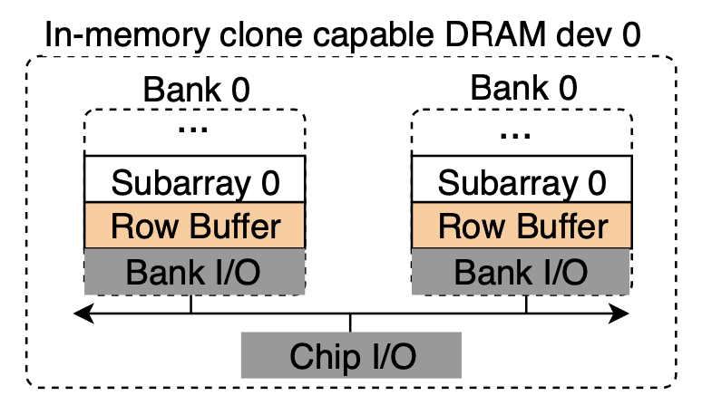
NetDIMM Hardware Architecture - Optimization
*RowClone-MICRO’13
src and dest share a same sub array
  Fast Parallel Mode (FPM)
Otherwise
  Pipeline Serial Mode (PSM)
  General Cloning Mode (GCM)
*Accelerate copies in the network stack
dst
src
Local/Private Channels
DRAM Devices
Row Buffer
Local Mem Ctrl
nController
nNIC
Global DDR
Channel
nCache
DDR5 PHY
nPref
Ethernet
Connector
NetDIMM buffer device
Smart memory allocation needed to unleash the FPM benefits

Slide 27
Outline
Introduction
Background
  DDR5 asynchronous memory operations
Network-attached DIMM
  NetDIMM hardware architecture
  NetDIMM software architecture
Evaluation
Conclusion

Slide 28
NetDIMM Software Architecture
Two components
NetDIMM memory management
  Physical memory mapping
  Memory allocation
NetDIMM driver
  Packet transmission and reception

Slide 29
NetDIMM Memory Management
**Accessed using DDR5 regular DRAM operations
Physical memory mapping
  Flex-channel mode
    ✅ Channel level parallelism for regular accesses
    ✅ Network packets goes to the right channel
Regular memory zone**
DDR0
Net0
0-64GB
Host
CPU
Mem Ctrl 0
64GB
64GB
256GB
64-128GB
128-192GB
DDR1
Net1
Mem Ctrl 1
64GB
64GB
192-256GB
NetDIMM 1 zone*
NetDIMM 0 zone*
*Accessed using DDR5 asynchronous NIVDIMM-P operations

Slide 30
NetDIMM Memory Management
Physical memory mapping
  Flex-channel mode
    ✅ Channel level parallelism for regular accesses
    ✅ Network packets goes to the right channel
Memory allocation
  Expose DRAM’s internal architecture to the memory scheduler
  __alloc_netdimm_pages(zone, hint)
  More details in the paper

Slide 31
NetDIMM Packet Reception (RX)
@System bootup: allocate descriptor rings and DMA buffers
@driver – polling agent
  Check RX ring for new packets
RX at nNIC
  DMA data to rx ring
DMA buffers
DRAM
Send()
Recv()
NetDIMM #0
Network SW Stack
SW
DDR5 DIMM
…
CPU & Caches
rx desc ring
TX
polling
RX
Memory Controller
nCache
nNIC
pkt
HW
Net0
Net1
Reg Mem
DDR
NetDIMM #1
Global/Shared Channel
NetDIMM Zones
Normal Zone

Slide 32
NetDIMM Packet Reception (RX)
@System bootup: allocate descriptor rings and DMA buffers
@driver – polling agent
  Check RX ring for new packets
RX at nNIC
  DMA data to rx ring
@driver RX engine
  allocate a skb on Net0 & invalidate skb
DMA buffers
DRAM
Send()
Recv()
NetDIMM #0
Network SW Stack
pkt
SW
DDR5 DIMM
…
CPU & Caches
rx desc ring
TX
polling
RX
Memory Controller
nCache
nNIC
HW
Net0
Net1
Reg Mem
DDR
NetDIMM #1
Global/Shared Channel
NetDIMM Zones
Normal Zone

Slide 33
NetDIMM Packet Reception (RX)
@System bootup: allocate descriptor rings and DMA buffers
@driver – polling agent
  Check RX ring for new packets
RX at nNIC
  DMA data to rx ring
@driver RX engine
  allocate a skb on Net0 & invalidate skb
  In-DRAM copy to skb
  Send skb ptr to network stack
@network stack/above
  Next line prefetch into nCache
DMA buffers
DRAM
Send()
Recv()
NetDIMM #0
Network SW Stack
pkt
pkt
$
$
$
$
$
pkt
SW
DDR5 DIMM
…
CPU & Caches
rx desc ring
TX
polling
RX
Memory Controller
pkt
nCache
nNIC
HW
Net0
Net1
Reg Mem
DDR
NetDIMM #1
pkt
Global/Shared Channel
NetDIMM Zones
Normal Zone
nCache improves NetDIMM access latency

Slide 34
Experimental Methodology
gem5 full-system simulation
  Linux and baremetal drivers
  Remove kernel software stack overhead
Facebook traces from three different clusters
Parameters | Values
Cores/freq | 8 / 3.4GHz/ 3ways
superscalar | 3 ways
Caches (size, assoc) I/D/L2 | 32KB, 2/64KB, 2/2MB,16ways
DRAM | DDR4-2400/2Channels
Network/#NetDIMMs | 40Gbps/1
PCIe | X8 PCIe 4
Configuration | Description
PCIe NIC | Discrete PCIe NIC
Intg NIC | Integrated NIC into CPU
ND Base | NetDIMM w/o RowClone
ND RowC | NetDIMM w/ RowClone

Slide 35
Experimental Results – Total Network Latency
NetDIMM without RowClone
NetDIMM with RowClone

Slide 36
Experimental Results – Total Network Latency
Vs. PCIe NIC
  Up to 50.7%
40.4%
50.7%
41.5%
50.3%
40.6%
46.1%

Slide 37
Experimental Results – Total Network Latency
Vs. PCIe NIC
  Up to 50.7%
Vs. intg NIC
  Up to 31.4%
17.1%
31.4%
14.9%
27.7%
3.7%
12.6%

Slide 38
Experimental Results – Network Latency Breakdown
2048 Bytes packet size

Slide 39
Experimental Results – Network Latency Breakdown
2048 Bytes packet size
Buffer copying improvements vs. PCIe:
  ND Base: 62.3% lower
  ND RowC: 90.5% lower

Slide 40
Experimental Results – Network Latency Breakdown
2048 Bytes packet size
Buffer copying improvements vs. PCIe:
  ND Base: 62.3% lower
  ND RowC: 90.5% lower
Rx and Tx DMA vs. PCIe
  ND Base and RowC: 59.0% lower

Slide 41
Cluster-Level Avg and 99th percentile Network Latency
↑ switch latency == ↓ latency gain

Slide 42
Cluster-Level Avg and 99th percentile Network Latency
↑ switch latency == ↓ latency gain
Hadoop:
  Lowest improvement among other clusters:
  Avg: 29% ~ 36%
  99th: 33% ~ 44%

Slide 43
Cluster-Level Avg and 99th percentile Network Latency
↑ switch latency == ↓ latency gain
Hadoop:
  Lowest improvement among other clusters:
  Avg: 29% ~ 36%
  99th: 33% ~ 44%
Webserver:
  Highest improvement among other clusters
  Avg: 36% ~ 44%
  99th: 48% ~ 67%

Slide 44
Conclusion
Need to rethink network architecture to optimize it for Latency and Bandwidth together
NetDIMM: Near-memory network interface architecture
  DDR5 asynch support for unified memory
  Leverage network data access pattern by prefetching and caching
  In-memory buffer cloning to reduce network stack data copying
Latency improvement without compromising bandwidth
  Up to 50.7% and 30.9% compared with PCIe and Integrated NICs
Opens an avenue for software define memory and composable architectures

Slide 45
Questions?

