Slide 1

Simulating PCI-Express Interconnect for Future System Exploration
Mohammad Alian, Krishna Parasuram Sirinivasan, Nam Sung Kim
University of Illinois Urbana-Champaign

Slide 2
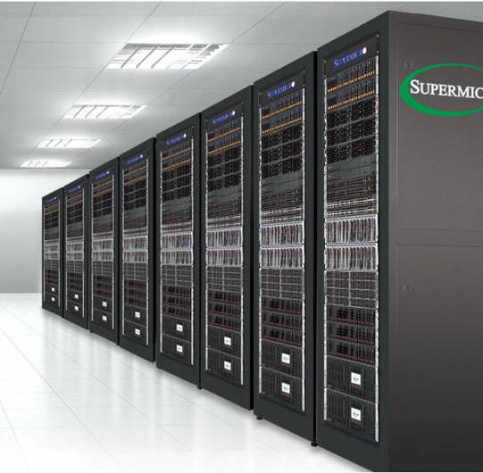
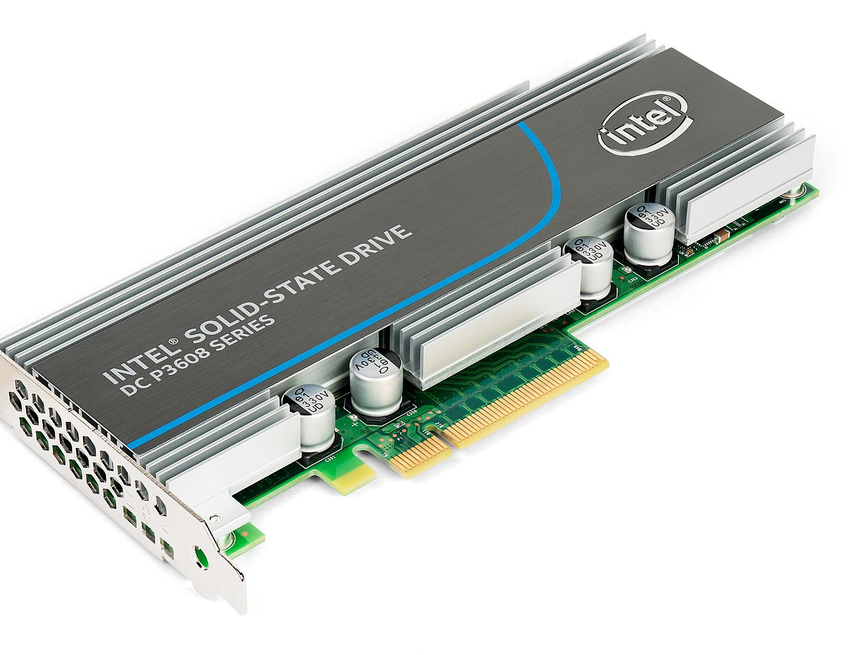
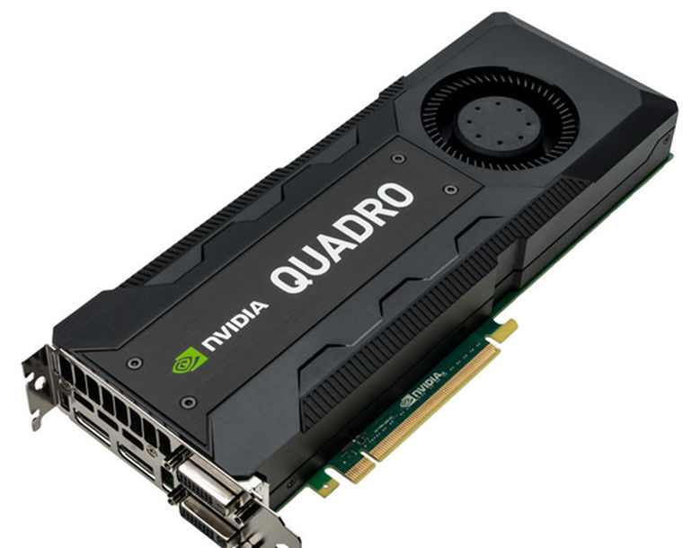
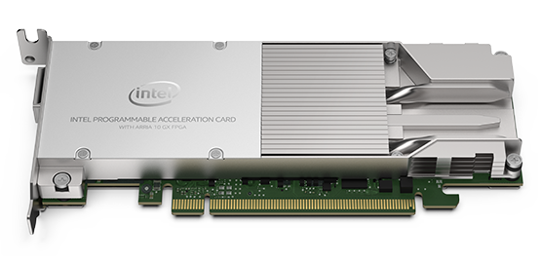
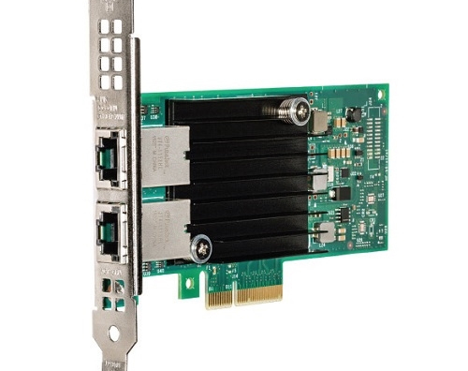
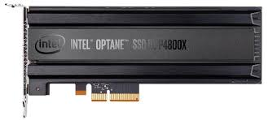
Motivation
PCIe is the dominant I/O interconnection technology
  Network Interface Card
  GPU
  SSD
  Accelerators
  Memory Drive Technology
  Emerging rack-scale systems

Slide 3
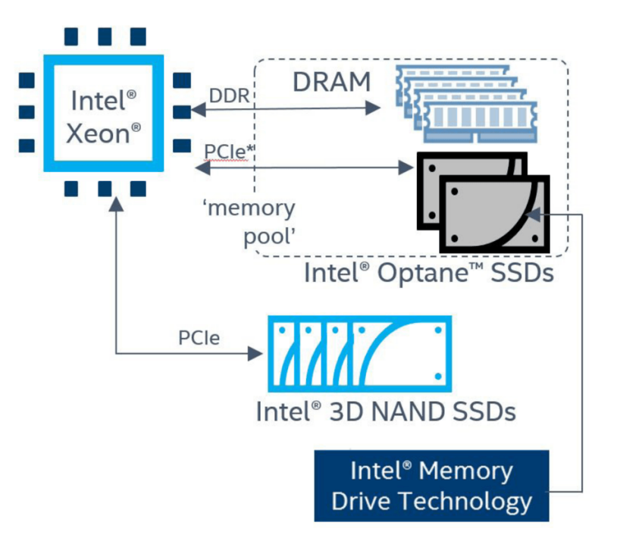
PCIe Use Case: Memory Drive Technology
Use Intel Optane SSD as Main Mem
Intel

Slide 4
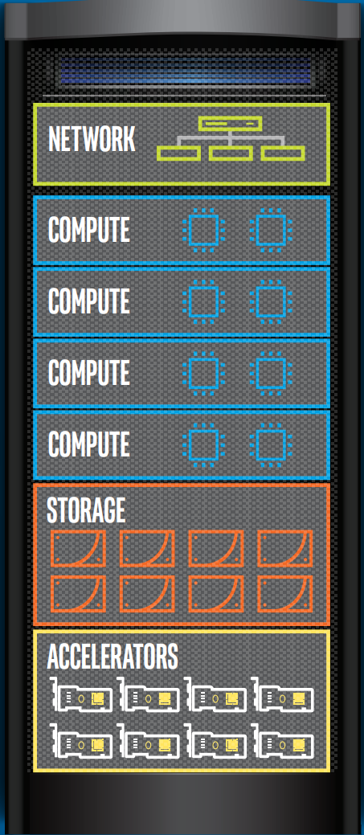
PCIe Use Case: Rack Scale Design
Compute, memory, storage, accelerators and network pool
PCIe Gen4

Slide 5
PCIe Use Case: Rack Scale Design
Compute, memory, storage, accelerators and network pool
M. Alian et al. “dist-gem5: Distributed Simulation of Computer Clusters,” ISPASS 2017
N. Binkert et al. “The gem5 simulator,” ACM SIGARCH 2011
A. Hansson et al. “Simulating DRAM controllers for future system architecture exploration,” ISPASS 2014
M. Jung et al. “SimpleSSD: Modeling Solid State Drives for Holistic System Simulation,” CAL’17
PCIe Gen4
J. Power et al. “gem5-gpu: A Heterogeneous CPU-GPU Simulator,“ CAL 2015

Slide 6
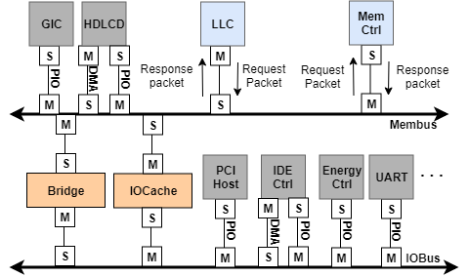
gem5 Off-chip Interconnection Model
Architectural simulators ignore I/O performance modeling
gem5 has a simple functional crossbar model for the I/O interconnection
  Loosely model a PCI bus
  Does not model the complex PCIe protocol
In this work we build a PCIe model for gem5
Slave port
Master port
gem5 IO architecture

Slide 7
Outline
Motivation
Background
  PCI vs. PCIe architecture
PCI-Express Modeling
  Enabling functionality (Detect a PCIe device)
  Performance modeling for root complex, switch, and links
Evaluation
Conclusion

Slide 8
Background: PCI Bus
Parallel bus
  33MHz (133 MB/sec) or 66MHz (533 MB/sec)
PCI Bridges form a hierarchy
Each bus supports up to 12 electrical loads
  bridges and endpoints
  4 shared interrupt lines
Does not support split transaction
Processor and Memory
Host-PCI
Bridge
….
Endpoint
Endpoint
PCI-PCI
Bridge
….
Endpoint
Endpoint
PCI-PCI
Bridge
….

Slide 9
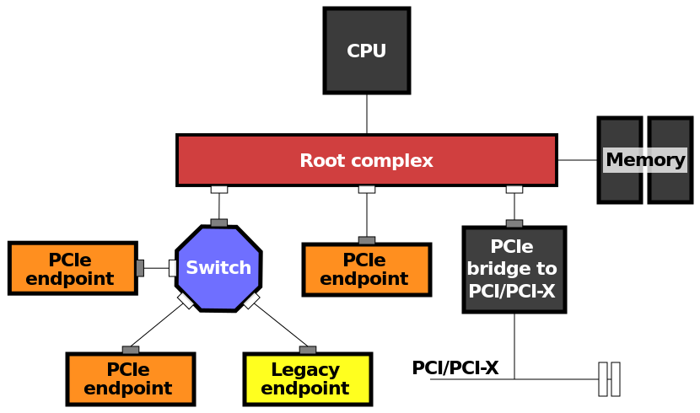
Background: PCIe Interconnection
Dual point to point serial connection
  x1, x2, x4, x8, x12, x16, x32
  Packet based protocol
  1GB/sec transfer rate for PCIe 3.0
  Split transactions
Each endpoint can work at a different speed
8b/10b and 128b/130b encoding
MSI/MSI-X interrupt handling
  Also supports legacy PCI interrupts
Additional capabilities
  Power management, error reporting, etc.
"PCI Express Basics". PCI-SIG.
Packet
Lane
Device A
…
Device B
Wire
Link

Slide 10
Background: PCIe Interconnection (cont.)
Layered architecture
  Transaction, Data Link, and Physical
Transaction Layer Packet (TLP) types
  Memory read/write
  I/O read/write
  Configuration read/write
  Messages
    Used for events like MSI
Device
Transaction layer
Data link layer
Physical layer
Transaction layer packet
to/from physical layer
of another device
Data link layer packet
start
seq
header
payload
ECRC
LCRC
end
Physical layer packet

Slide 11
Our Approach to Enable PCIe in gem5
Take a PCI device model as a base and enable it to work with PCI Express driver
  Define necessary configuration space registers and data structures
  Enable the driver to read/write from/to the configuration space
  Set read-only configuration registers
Implement root complex and PCIe switch models
  Create a functional model that represents PCIe hierarchy
Implement timing models for PCIe link and switches
  Configurable latency and bandwidth
  ACK/NAK protocol
Enable functionality
Add performance modeling

Slide 12
Our Approach to Enable PCIe in gem5
Take a PCI device model as a base and enable it to work with PCI Express driver
  Define necessary configuration space registers and data structures
  Enable the driver to read/write from/to the configuration space
  Set read-only configuration registers
Implement root complex and PCIe switch models
  Create a model that represents PCIe hierarchy
Implement a PCIe link model
  Configurable latency and bandwidth
  ACK/NAK protocol

Slide 13
Our Approach to Enable PCIe in gem5
Take a PCI device model as a base and enable it to work with PCI Express driver
  Define necessary configuration space registers and data structures
  Enable the driver to read/write from/to the configuration space
  Set read-only configuration registers
Implement root complex and PCIe switch models
  Create a model that represents PCIe hierarchy
Implement a PCIe link model
  Configurable latency and bandwidth
  ACK/NAK protocol

Slide 14
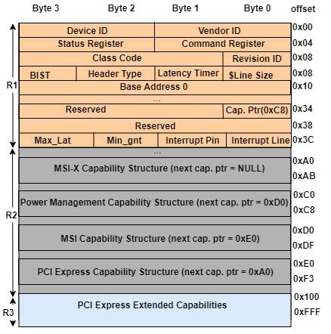
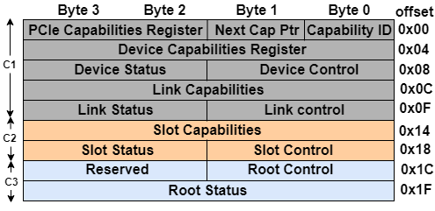
PCI-Express Endpoint Configuration Header
Used to match a device with a device driver
256Bytes
PCI and PCIe
PCIe only
Endpoint Configuration Header

Slide 15
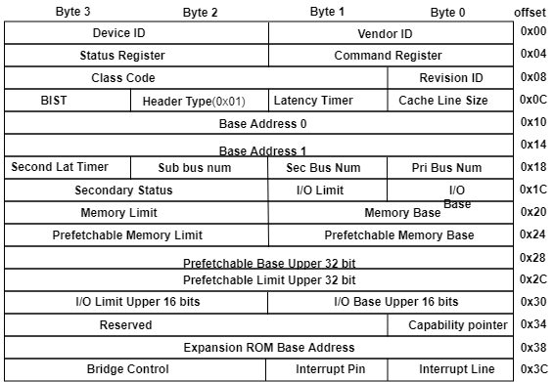
Virtual P2P Bridge Configuration Header

Slide 16
PCIe Enumeration
During system boot up
Detect active PCIe devices
Initialize their Base Address Register (BAR)
Uses Bus:Device:Function (BDF) addressing
  00:02.0 => bus 0, device 2, function 0

Slide 17
PCIe Enumeration
Root Complex
Host Bridge
P2P
P2P
P2P
P2P
Switch
endpoint
P2P
P2P
P2P
endpoint

Slide 18
PCIe Enumeration
Root Complex
Before PCIe Enumeration
  Assuming single function devices (function number is 0 for all devices)
Enumeration sets:
  Bus number
  Secondary bus number (sec)
    Minimum bus number in the tree
  Subordinate bus number (sub)
    Maximum bus number in the tree
Host Bridge
dev 0
sec
sub
dev 1
sec
sub
dev 2
sec
sub
dev 0
sec
sub
Switch
dev 0
dev 0
sec
sub
dev 1
sec
sub
dev 2
sec
sub
dev 0

Slide 19
PCIe Enumeration
Root Complex
Before PCIe Enumeration
  Assuming single function devices (function number is 0 for all devices)
Enumeration sets:
  Bus number
  Secondary bus number (sec)
    Minimum bus number in the tree
  Subordinate bus number (sub)
    Maximum bus number in the tree
Host Bridge
bus 0
dev 0
sec
sub
dev 1
sec
sub
dev 2
sec
sub
dev 0
sec
sub
Switch
dev 0
dev 0
sec
sub
dev 1
sec
sub
dev 2
sec
sub
dev 0

Slide 20
PCIe Enumeration
Root Complex
Before PCIe Enumeration
  Assuming single function devices (function number is 0 for all devices)
Enumeration sets:
  Bus number
  Secondary bus number (sec)
    Minimum bus number in the tree
  Subordinate bus number (sub)
    Maximum bus number in the tree
Host Bridge
bus 0
dev 0
sec 1
sub 255
dev 1
sec
sub
dev 2
sec
sub
bus 1
dev 0
sec
sub
Switch
dev 0
dev 0
sec
sub
dev 1
sec
sub
dev 2
sec
sub
dev 0

Slide 21
PCIe Enumeration
Root Complex
Before PCIe Enumeration
  Assuming single function devices (function number is 0 for all devices)
Enumeration sets:
  Bus number
  Secondary bus number (sec)
    Minimum bus number in the tree
  Subordinate bus number (sub)
    Maximum bus number in the tree
Host Bridge
bus 0
dev 0
sec 1
sub 255
dev 1
sec
sub
dev 2
sec
sub
bus 1
dev 0
sec 2
sub 255
Switch
dev 0
bus 2
dev 0
sec
sub
dev 1
sec
sub
dev 2
sec
sub
dev 0

Slide 22
PCIe Enumeration
Root Complex
Before PCIe Enumeration
  Assuming single function devices (function number is 0 for all devices)
Enumeration sets:
  Bus number
  Secondary bus number (sec)
    Minimum bus number in the tree
  Subordinate bus number (sub)
    Maximum bus number in the tree
Host Bridge
bus 0
dev 0
sec 1
sub 255
dev 1
sec
sub
dev 2
sec
sub
bus 1
dev 0
sec 2
sub 255
Switch
dev 0
bus 2
dev 0
sec 3
sub 255
dev 1
sec
sub
dev 2
sec
sub
bus 3
dev 0

Slide 23
PCIe Enumeration
Root Complex
Before PCIe Enumeration
  Assuming single function devices (function number is 0 for all devices)
Enumeration sets:
  Bus number
  Secondary bus number (sec)
    Minimum bus number in the tree
  Subordinate bus number (sub)
    Maximum bus number in the tree
Host Bridge
bus 0
dev 0
sec 1
sub 255
dev 1
sec
sub
dev 2
sec
sub
bus 1
dev 0
sec 2
sub 255
Switch
dev 0
bus 2
dev 0
sec 3
sub 3
dev 1
sec
sub
dev 2
sec
sub
bus 3
dev 0

Slide 24
PCIe Enumeration
Root Complex
Before PCIe Enumeration
  Assuming single function devices (function number is 0 for all devices)
Enumeration sets:
  Bus number
  Secondary bus number (sec)
    Minimum bus number in the tree
  Subordinate bus number (sub)
    Maximum bus number in the tree
Host Bridge
bus 0
dev 0
sec 1
sub 255
dev 1
sec
sub
dev 2
sec
sub
bus 1
dev 0
sec 2
sub 255
Switch
dev 0
bus 2
dev 0
sec 3
sub 3
dev 1
sec 255
sub 0
dev 2
sec
sub
bus 3
dev 0

Slide 25
PCIe Enumeration
Root Complex
Before PCIe Enumeration
  Assuming single function devices (function number is 0 for all devices)
Enumeration sets:
  Bus number
  Secondary bus number (sec)
    Minimum bus number in the tree
  Subordinate bus number (sub)
    Maximum bus number in the tree
Host Bridge
bus 0
dev 0
sec 1
sub 255
dev 1
sec
sub
dev 2
sec
sub
bus 1
dev 0
sec 2
sub 255
Switch
dev 0
bus 2
dev 0
sec 3
sub 3
dev 1
sec 255
sub 0
dev 2
sec 255
sub 0
bus 3
dev 0

Slide 26
PCIe Enumeration
Root Complex
Before PCIe Enumeration
  Assuming single function devices (function number is 0 for all devices)
Enumeration sets:
  Bus number
  Secondary bus number (sec)
    Minimum bus number in the tree
  Subordinate bus number (sub)
    Maximum bus number in the tree
Host Bridge
bus 0
dev 0
sec 1
sub 255
dev 1
sec
sub
dev 2
sec
sub
bus 1
dev 0
sec 2
sub 3
Switch
dev 0
bus 2
dev 0
sec 3
sub 3
dev 1
sec 255
sub 0
dev 2
sec 255
sub 0
bus 3
dev 0

Slide 27
PCIe Enumeration
Root Complex
Before PCIe Enumeration
  Assuming single function devices (function number is 0 for all devices)
Enumeration sets:
  Bus number
  Secondary bus number (sec)
    Minimum bus number in the tree
  Subordinate bus number (sub)
    Maximum bus number in the tree
Host Bridge
bus 0
dev 0
sec 1
sub 3
dev 1
sec
sub
dev 2
sec
sub
bus 1
dev 0
sec 2
sub 3
Switch
dev 0
bus 2
dev 0
sec 3
sub 3
dev 1
sec 255
sub 0
dev 2
sec 255
sub 0
bus 3
dev 0

Slide 28
PCIe Enumeration
Root Complex
Before PCIe Enumeration
  Assuming single function devices (function number is 0 for all devices)
Enumeration sets:
  Bus number
  Secondary bus number (sec)
    Minimum bus number in the tree
  Subordinate bus number (sub)
    Maximum bus number in the tree
Host Bridge
bus 0
dev 0
sec 1
sub 3
dev 1
sec 255
sub 0
dev 2
sec 4
sub 4
bus 1
bus 4
dev 0
sec 2
sub 3
Switch
dev 0
bus 2
dev 0
sec 3
sub 3
dev 1
sec 255
sub 0
dev 2
sec 255
sub 0
bus 3
dev 0

Slide 29
PCIe Enumeration
Root Complex
Before PCIe Enumeration
  Assuming single function devices (function number is 0 for all devices)
Enumeration sets:
  Bus number
  Secondary bus number (sec)
    Minimum bus number in the tree
  Subordinate bus number (sub)
    Maximum bus number in the tree
Initialize BAR using BDF addressing
  assign IO and memory space
Host Bridge
bus 0
dev 0
sec 1
sub 3
dev 1
sec 255
sub 0
dev 2
sec 4
sub 4
bus 1
bus 4
dev 0
sec 2
sub 3
Switch
dev 0
bus 2
dev 0
sec 3
sub 3
dev 1
sec 255
sub 0
dev 2
sec 255
sub 0
bus 3
dev 0

Slide 30
Our Approach to Enable PCIe in gem5
Take a PCI device model as a base and enable it to work with PCI Express driver
  Define necessary configuration space registers and data structures
  Enable the driver to read/write from/to the configuration space
  Set read-only configuration registers
Implement root complex and PCIe switch models
  Create a model that represents PCIe hierarchy
Implement a PCIe link model
  Configurable latency and bandwidth
  ACK/NAK protocol

Slide 31
Root Complex Model
PIO Requests
DMA Requests
LLC
Memory Ctrl
Master port (M)
  Request
Slave ports (S)
  response
Root complex is connected to the Mem Bus
  Used an IO cache for DMA transaction to enforce coherency
P2P bridges perform packet routing
  based on I/O and memory address space
Configurable latency and bandwidth
Memory Bus
M
S
M
IOCache
S
Root Complex
S
M
Internal Bus 0
P2P
P2P
P2P
Root Port 1
Root Port 2
Root Port 3
S
M
S
M
S
M
M
S
M
S
M
S
Switch
endpoint
endpoint

Slide 32
Our Approach to Enable PCIe in gem5
Take a PCI device model as a base and enable it to work with PCI Express driver
  Define necessary configuration space registers and data structures
  Enable the driver to read/write from/to the configuration space
  Set read-only configuration registers
Implement root complex and PCIe switch models
  Create a model that represents PCIe hierarchy
Implement a PCIe link model
  Configurable latency and bandwidth
  ACK/NAK protocol

Slide 33
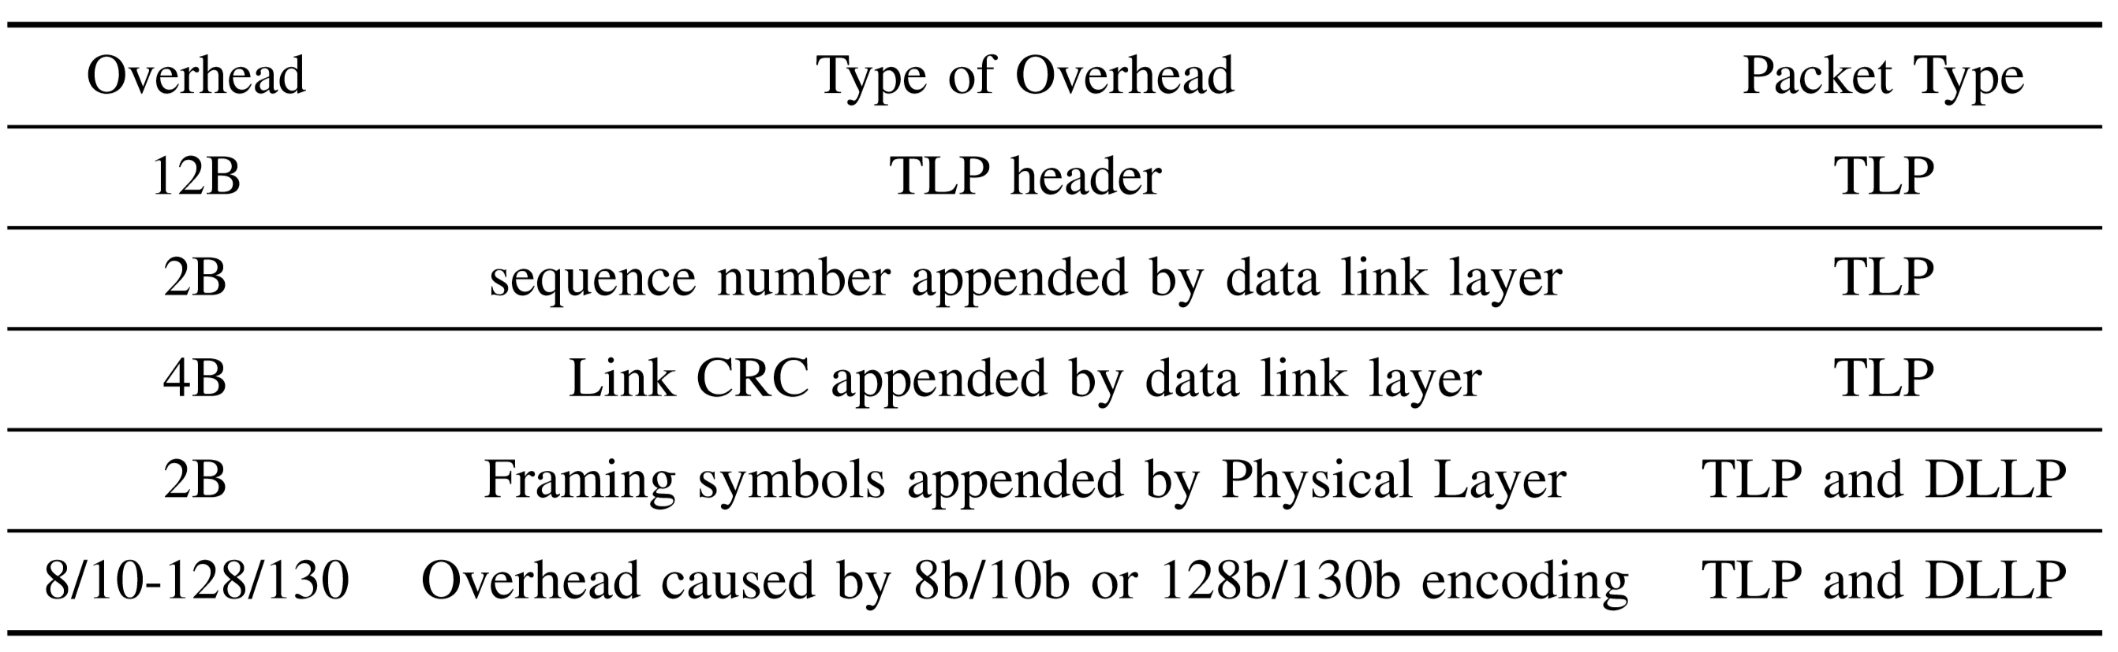
PCIe Link Model
Consists of two unidirectional links
Configurable latency and bandwidth
  model different lane width/generation
Add overhead of protocol layers
pcie-pkt
S
M
RX Logic
TX Logic
S
M
Root Complex/Switch
Downstream Port
pcie-pkt
Endpoint/Switch Upstream Port
M
S
TX Logic
RX Logic
M
S

Slide 34
PCIe Link Model
pcie-pkt
S
M
RX Logic
TX Logic
S
M
Root Complex/Switch
Downstream Port
pcie-pkt
Endpoint/Switch Upstream Port
M
S
TX Logic
RX Logic
M
S

Slide 35
PCIe Link Model
pcie-pkt
S
M
RX Logic
TX Logic
S
M
Root Complex/Switch
Downstream Port
pcie-pkt
Endpoint/Switch Upstream Port
M
S
TX Logic
RX Logic
M
S

Slide 36
PCIe Link Model
pcie-pkt
S
M
RX Logic
TX Logic
S
M
Root Complex/Switch
Downstream Port
pcie-pkt
Endpoint/Switch Upstream Port
M
S
TX Logic
RX Logic
M
S
packet
S
Seq Gen
Seq Check
M
S0
S1
S1
NO
S0
is
Ack Timer
MUX
ack
Reply buffer
Reply buffer
YES
Reply Timer
Reply Timer
Dequeue
is
ack
Notes:
Reply timer starts from 0 when the last byte of any TLP is sent. It restarts when a new TLP is sent or when an ACK DLLP is received that references a packet in the replay buffer.

Slide 37
PCIe Link Model
pcie-pkt
S
M
RX Logic
TX Logic
S
M
Root Complex/Switch
Downstream Port
pcie-pkt
Endpoint/Switch Upstream Port
M
S
TX Logic
RX Logic
M
S
S
Seq Gen
Reply Timer
Timer
M
Next Seq
seq
Ack/NAC Gen
Reply buffer
check
seq
OK
check
Notes:
Reply timer starts from 0 when the last byte of any TLP is sent. It restarts when a new TLP is sent or when an ACK DLLP is received that references a packet in the replay buffer.

Slide 38
PCIe Link Model
pcie-pkt
S
M
RX Logic
TX Logic
S
M
Root Complex/Switch
Downstream Port
pcie-pkt
Endpoint/Switch Upstream Port
M
S
TX Logic
RX Logic
M
S
packet
S
Seq Gen
Reply Timer
Timer
M
Next Seq
0
seq
Ack/NAC Gen
Reply buffer
check
seq
OK
check
Notes:
Reply timer starts from 0 when the last byte of any TLP is sent. It restarts when a new TLP is sent or when an ACK DLLP is received that references a packet in the replay buffer.

Slide 39
PCIe Link Model
pcie-pkt
S
M
RX Logic
TX Logic
S
M
Root Complex/Switch
Downstream Port
pcie-pkt
Endpoint/Switch Upstream Port
M
S
TX Logic
RX Logic
M
S
packet
S
Seq Gen
Reply Timer
Timer
M
Next Seq
0
seq
Ack/NAC Gen
Reply buffer
check
seq
OK
check
Notes:
Reply timer starts from 0 when the last byte of any TLP is sent. It restarts when a new TLP is sent or when an ACK DLLP is received that references a packet in the replay buffer.

Slide 40
PCIe Link Model
pcie-pkt
S
M
RX Logic
TX Logic
S
M
Root Complex/Switch
Downstream Port
pcie-pkt
Endpoint/Switch Upstream Port
M
S
TX Logic
RX Logic
M
S
packet
S
Seq Gen
Reply Timer
Timer
M
Next Seq
0
seq
Ack/NAC Gen
Reply buffer
check
seq
OK
check
Notes:
Reply timer starts from 0 when the last byte of any TLP is sent. It restarts when a new TLP is sent or when an ACK DLLP is received that references a packet in the replay buffer.

Slide 41
PCIe Link Model
pcie-pkt
S
M
RX Logic
TX Logic
S
M
Root Complex/Switch
Downstream Port
pcie-pkt
Endpoint/Switch Upstream Port
M
S
TX Logic
RX Logic
M
S
packet
S
Seq Gen
Reply Timer
Timer
M
Next Seq
0
seq
Ack/NAC Gen
Reply buffer
check
S0
seq
OK
check
Notes:
Reply timer starts from 0 when the last byte of any TLP is sent. It restarts when a new TLP is sent or when an ACK DLLP is received that references a packet in the replay buffer.

Slide 42
PCIe Link Model
pcie-pkt
S
M
RX Logic
TX Logic
S
M
Root Complex/Switch
Downstream Port
pcie-pkt
Endpoint/Switch Upstream Port
M
S
TX Logic
RX Logic
M
S
packet
S
Seq Gen
Reply Timer
Timer
M
Next Seq
0
seq
Ack/NAC Gen
Reply buffer
check
S1
seq
OK
check
Notes:
Reply timer starts from 0 when the last byte of any TLP is sent. It restarts when a new TLP is sent or when an ACK DLLP is received that references a packet in the replay buffer.

Slide 43
PCIe Link Model
pcie-pkt
S
M
RX Logic
TX Logic
S
M
Root Complex/Switch
Downstream Port
pcie-pkt
Endpoint/Switch Upstream Port
M
S
TX Logic
RX Logic
M
S
packet
S
Seq Gen
Reply Timer
Timer
M
Next Seq
1
seq
Ack/NAC Gen
Reply buffer
check
S0
seq
OK
check
Notes:
Reply timer starts from 0 when the last byte of any TLP is sent. It restarts when a new TLP is sent or when an ACK DLLP is received that references a packet in the replay buffer.

Slide 44
PCIe Link Model
pcie-pkt
S
M
RX Logic
TX Logic
S
M
Root Complex/Switch
Downstream Port
pcie-pkt
Endpoint/Switch Upstream Port
M
S
TX Logic
RX Logic
M
S
packet
S
Seq Gen
Reply Timer
Timer
M
Next Seq
1
seq
Ack/NAC Gen
Reply buffer
check
S1
seq
OK
check
Notes:
Reply timer starts from 0 when the last byte of any TLP is sent. It restarts when a new TLP is sent or when an ACK DLLP is received that references a packet in the replay buffer.

Slide 45
PCIe Link Model
pcie-pkt
S
M
RX Logic
TX Logic
S
M
Root Complex/Switch
Downstream Port
pcie-pkt
Endpoint/Switch Upstream Port
M
S
TX Logic
RX Logic
M
S
packet
S
Seq Gen
Reply Timer
Timer
M
Next Seq
1
seq
Ack/NAC Gen
Reply buffer
check
S1
seq
OK
check
Notes:
Reply timer starts from 0 when the last byte of any TLP is sent. It restarts when a new TLP is sent or when an ACK DLLP is received that references a packet in the replay buffer.

Slide 46
PCIe Link Model
pcie-pkt
S
M
RX Logic
TX Logic
S
M
Root Complex/Switch
Downstream Port
pcie-pkt
Endpoint/Switch Upstream Port
M
S
TX Logic
RX Logic
M
S
packet
S
Seq Gen
Reply Timer
Timer
M
Next Seq
1
seq
Ack/NAC Gen
Reply buffer
check
S0
S1
seq
OK
check
Notes:
Reply timer starts from 0 when the last byte of any TLP is sent. It restarts when a new TLP is sent or when an ACK DLLP is received that references a packet in the replay buffer.

Slide 47
PCIe Link Model
pcie-pkt
S
M
RX Logic
TX Logic
S
M
Root Complex/Switch
Downstream Port
pcie-pkt
Endpoint/Switch Upstream Port
M
S
TX Logic
RX Logic
M
S
packet
S
Seq Gen
Reply Timer
Timer
M
Next Seq
1
seq
Ack/NAC Gen
S0
Reply buffer
check
S1
seq
OK
check
Notes:
Reply timer starts from 0 when the last byte of any TLP is sent. It restarts when a new TLP is sent or when an ACK DLLP is received that references a packet in the replay buffer.

Slide 48
PCIe Link Model
pcie-pkt
S
M
RX Logic
TX Logic
S
M
Root Complex/Switch
Downstream Port
pcie-pkt
Endpoint/Switch Upstream Port
M
S
TX Logic
RX Logic
M
S
packet
S
Seq Gen
Reply Timer
Timer
M
Next Seq
1
seq
Ack/NAC Gen
S0
Reply buffer
check
seq
OK
check
Notes:
Reply timer starts from 0 when the last byte of any TLP is sent. It restarts when a new TLP is sent or when an ACK DLLP is received that references a packet in the replay buffer.

Slide 49
PCIe Link Model
pcie-pkt
S
M
RX Logic
TX Logic
S
M
Root Complex/Switch
Downstream Port
pcie-pkt
Endpoint/Switch Upstream Port
M
S
TX Logic
RX Logic
M
S
packet
S
Seq Gen
Reply Timer
Timer
M
Next Seq
1
seq
Ack/NAC Gen
Reply buffer
check
seq
OK
check
Notes:
Reply timer starts from 0 when the last byte of any TLP is sent. It restarts when a new TLP is sent or when an ACK DLLP is received that references a packet in the replay buffer.

Slide 50
Methodology
Physical setup
Xeon V4 E5 2660 processor, Intel p3700 SSD
Run “dd” to flood storage device with read/write requests
gem5 setup
Configure it to model the Xeon processor
IDE disk model does not impose any bandwidth bottleneck

Slide 51
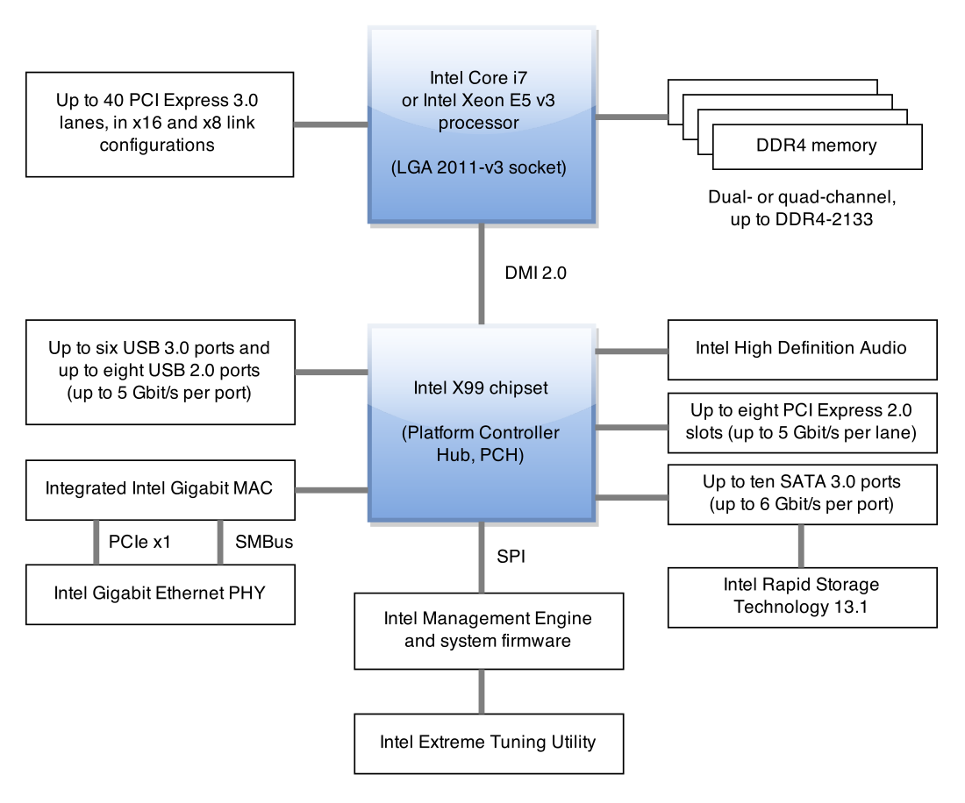
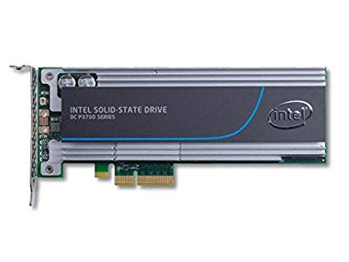
Validation
Physical Setup
gem5 Setup
Root Complex
PCIe gen2 x4
Switch
PCIe gen2 x1
~5Gbps
IDE Disk

Slide 52
Validation
Different switch latency and access block size
  Within 80% ~ 90% of physical bandwidth
Switch latency

Slide 53
Bandwidth vs. Lane Width
BW drop from x4 to x8!
Switch port becomes the bottleneck
  Frequent replays – 27% of pkts
Nonintuitive behavior which cannot be captured with a simple interconnection model

Slide 54
Conclusion

Slide 55
Backup slides

